Slide 1
Image lossy compression/decompression method using DCT.
Student: Nguyễn Trường Giang – 1551034.
Instructor: Associate Prof. PhD Đỗ Hồng Tuấn.

Slide 2
Introduction
As our use of and reliance on computers continues to grow, so does the need for efficient ways of storing large amounts of data.
Two kind of categories: lossless and lossy image compression.
JPEG is an lossy image compression using Discrete Cosine Transform to separate into parts of different frequencies. Then apply a process called quantization, where the less important information are discarded → reconstructed image contain distortion but size of image are reduced.

Slide 3
Overview the process
The image broken into 8x8 blocks of pixels.
Working from left to right, top to bottom, the DCT is applied to each block.
Each block is compressed through quantization.
The array of compressed blocks that constitute the image is stored/ transmitted in a less amount of size.
When desired, the image is reconstructed through decompression, using Inverse Discrete Cosine Transform (IDCT).

Slide 4
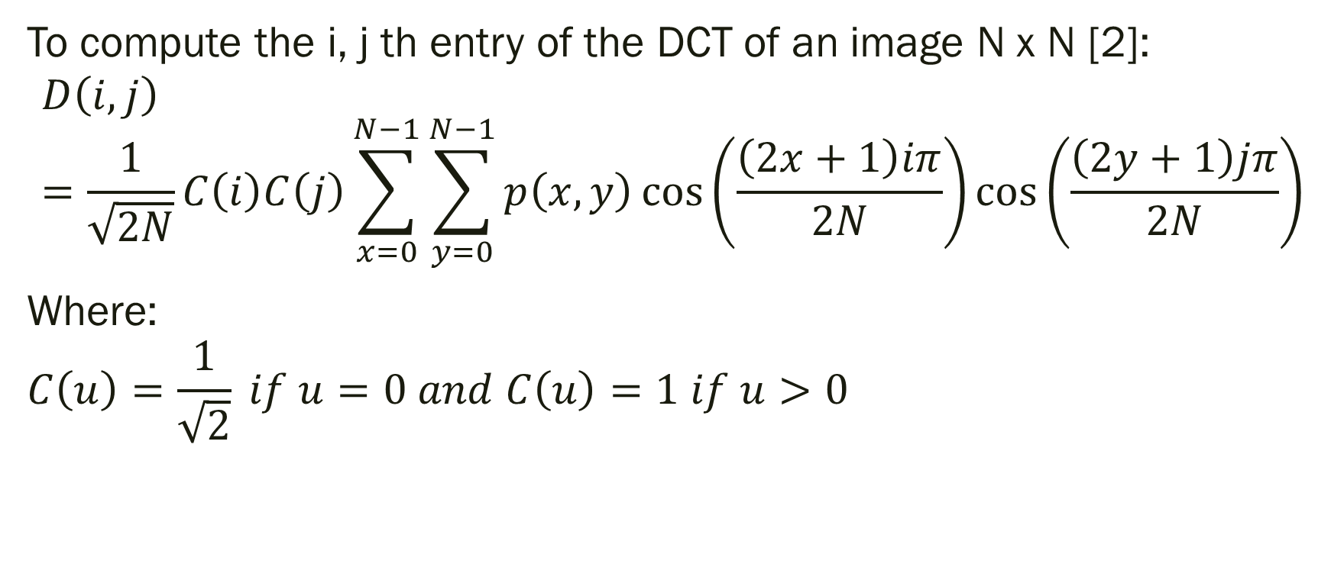
DCT Equation
To compute the i, j th entry of the DCT of an image N x N [2]:
$$D\left(i,j\right)=\frac{1}{\sqrt{2N}}C\left(i\right)C\left(j\right)\sum_{x=0}^{N−1}{\sum_{y=0}^{N−1}{p\left(x,y\right)\cos\left(\frac{\left(2x+1\right)iπ}{2N}\right)cos\left(\frac{\left(2y+1\right)jπ}{2N}\right)}}$$
Where:
$$C\left(u\right)=\frac{1}{\sqrt{2}} if u=0 and C\left(u\right)=1 if u>0$$

Slide 5
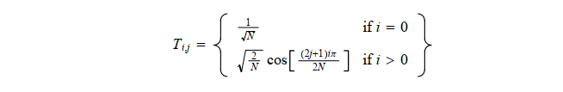
DCT Matrix
To get the matrix form from above, we will use the following equation [1]:

Slide 6
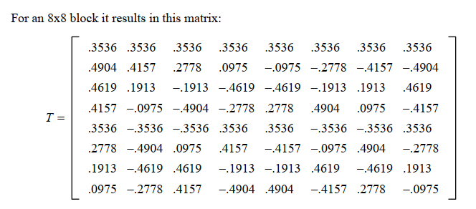
DCT Matrix

Slide 7
Doing the DCT on an 8x8 Block
Since an image comprises hundred or even thousands of 8x8 blocks of pixels, the following description of what happen to one 8x8 block in JPEG process.
After what is done with one block we continues to do with the rest of an image.

Slide 8
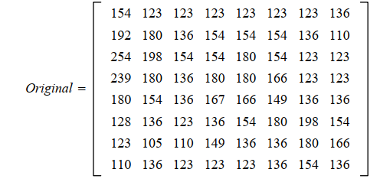
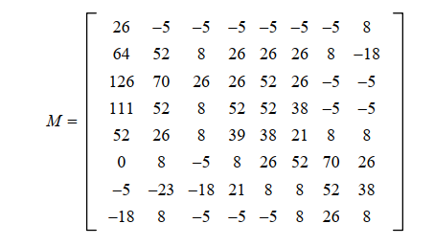

Doing DCT on an 8x8 Block

Slide 9
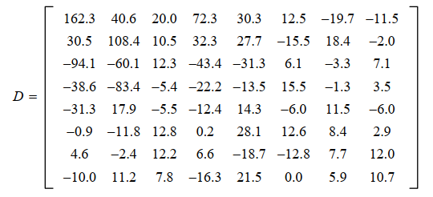
Doing DCT on an 8x8 Block

Slide 10
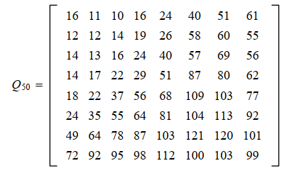

Quantization
Now our 8x8 block of DCT is ready for compression by quantization.
With the level of n, the 8x8 quantization table is calculated by :
$$Q\left(n\right)=Q50∗\frac{100−n}{50} with n≥50$$
$$Q\left(n\right)=Q50 ∗\frac{50}{n} with n<50$$
Q50 is basic matrix defined in [1].

Slide 11
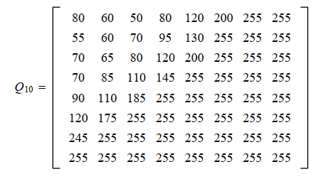
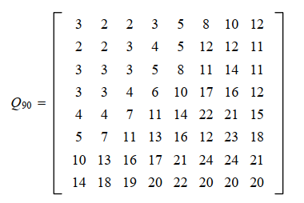
Quantization

Slide 12
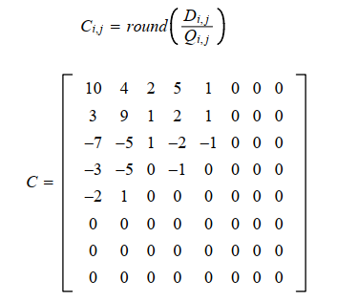
Quantization

Slide 13
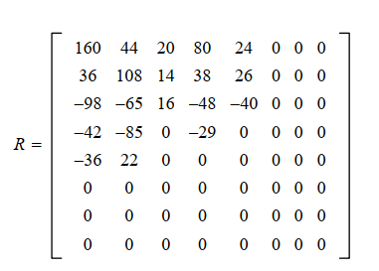

Decompression
Reconstruction of our image begin by multiply the matrix C to the quantization matrix originally used.
$$R_{i,j}=Q_{i,j} x C_{i,j}$$

Slide 14

Inverse DCT
The IDCT is next applied to matrix R, which is rounded to the nearest integer. Finally, 128 is added to each element of that result, giving us the decompressed JPEG version N of our original 8x8 image block M
[1]

Slide 15
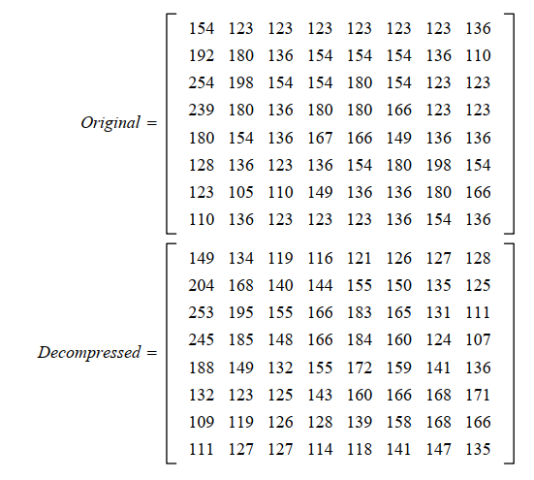
Comparison of Matrices

Slide 16
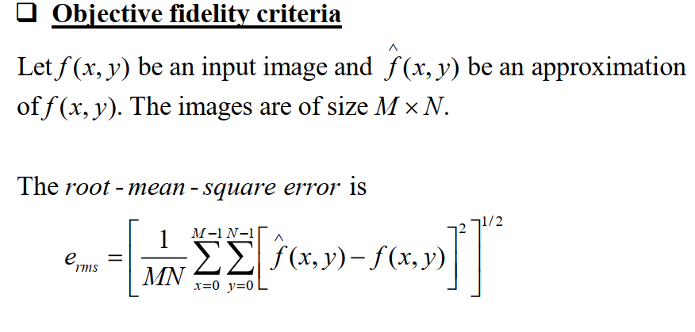
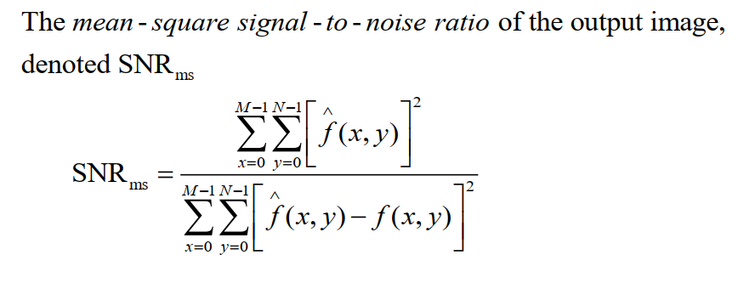
Evaluation

Slide 17


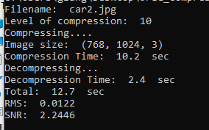


Example:

Slide 18

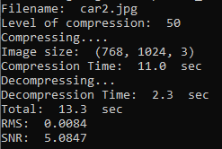

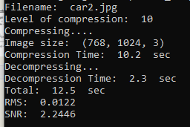
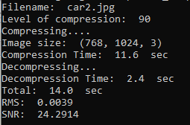
Example:
Original file

Slide 19
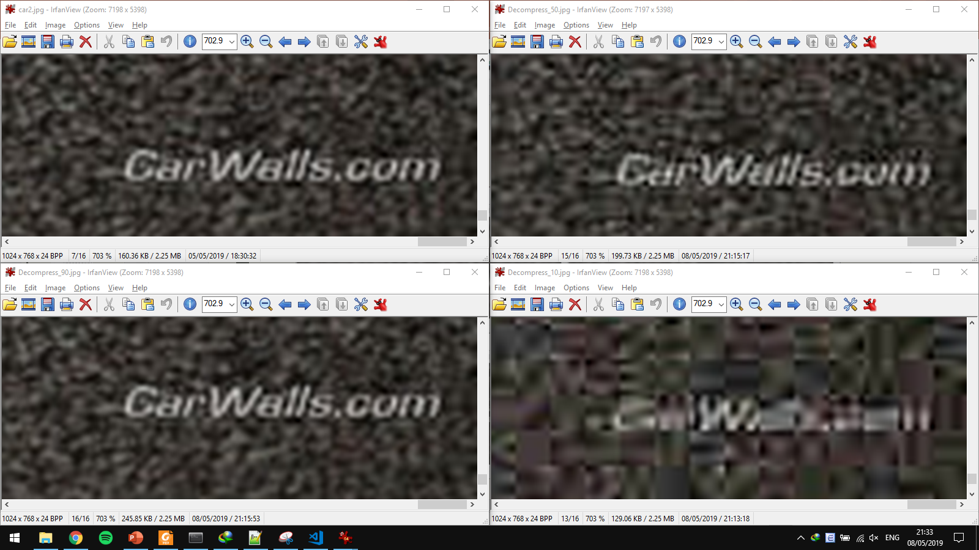
Example

Slide 20
Comparison table
Device: Dell Latitude E6430, Intel Core i7 – 3520M, 8GB RAM, Window 10 64bit.
Software: Anaconda 4.6.14 Jupyter Notebook, Python 3.6.8
 | Size | Level of Compression | Time (sec) | RMS | SNR
 | (256, 256, 3) | 30 | 1.133 | 0.0376 | 3.5249
 |  | 50 | 1.201 | 0.0343 | 4.1059
 |  | 90 | 1.259 | 0.0177 | 16.4038
 | (768, 1024, 3) | 30 | 13.187 | 0.0095 | 4.0506
 |  | 50 | 13.789 | 0.0084 | 5.0847
 |  | 90 | 13.989 | 0.0039 | 24.2914

Slide 21
Conclusion
Different level of compression give almost the same image for human eyes, but for computer vision, the original and the “after process” image is very different.
As you increase the size of image, the process will take longer to compute.
Bigger level of compression will take longer to process, RMS will decrease, SNR increase
→ the quality is almost the same with the original.

Slide 22
References
[1] Image Compression and the Discrete Cosine Transform
by Ken Cabeen and Peter Gent – College of the Redwoods https://www.math.cuhk.edu.hk/~lmlui/dct.pdf
[2] Lecture Note in Digital Image Processing 2018 at HCMUT
by Associate Prof. PhD Đỗ Hồng Tuấn.

Slide 23
Thank you

